Slide 1
WFTO Europe
2014 Mennorode

Slide 2
Overview for Welcome
Figures reviewed by the Board each month
Produced within a few days of the month end
Year end accounts completed in good time
Auditor is happier!
2013 positive result added to reserves

Slide 3
Results – Income

Slide 4
Results – Expenses

Slide 5
Results – 2013 Balance sheet
Assets | 2012 (€) | 2013 (€)
1. IMMOBILISED ASSETS |  |  | 925,75
1.1 Intangible asset
1.2 Tangible asset
1.4 Financial asset
1.4.1 office deposit | 810,75 | 810,75
1.4.2 social secretariat guarantee |  | 115
2. CURRENT ASSETS |  |  | 44235,49
2.1 Provisions for bad debt
2.2 Cash and bank accounts | 21.084,53
2.2.1Triodos BE - Savings Account |  | 36184,56
2.2.2 Triodos BE - Currents Account |  | 0
2.2.3 KBC BE - Currents Account |  | 108,64
2.2.4 Triodos ESP - Corporativa |  | 0
2.2.5 Triodos ESP - Empresa |  | 6,5
2.2.6 Cash |  | 38,04
2.3 Prepayment and accrued income | 11.337,88 | 7897,75
TOTAL ASSET | 33.233,16 |  | 45.161,24
Liabilities | 2012 (€) | 2013 (€)
1. NET WORTH |  |  | 37015,24
1.1 Net result of previous years | 27.514,91 | 31803,55
1.2 Net result of the year | 4.288,64 | 5211,69
2. PROVISIONS AND TAXES |  |  | 0
3. DEBTS |  |  | 8146
3.1 Long term debt (more than one year)
3.2 Short term debt (1 year or more)
3.2.1 Financial, social , salarial debts |  | 3805,16
3.4 Accrual and deferred income | 1.429,61 | 4340,84
TOTAL LIABILITIES | 33.233,16 |  | 45161,24

Slide 6
Results – 2013 Income
INCOME | 2012 (€) | 2013 (€)
1. CORE INCOME
1.1 Membership, donations, external funding |  |  | 79337,82
1.1.1 Membership fees + decentralisation | 18316 | 56600
Membership fees not received |  | -100
1.1.1.1 WFTO Membership Handling fees | 400 | 300
Prepayment WFTO | 425
1.1.2 Donations |  | 147,65
1.1.3 External funding | 26227,14
1.1.3.1 EU Project (Vote4FT) |  | 21364,59
1.1.3.2 Training subsidy |  | 419,64
1.1.3.3 BTC Project (fair trade week) |  | 605,94
1.2 Other income | 24751,17 |  | 4751,18
2. FINANCIAL INCOME | 351,85 |  | 366,91
TOTAL GENERAL | 70.471,16 |  | 84.455,91

Slide 7
Results – 2013 Expenditure
EXPENSES | 2012 (€) | 2013 (€)
1. CORE EXPENSES
1.1 Staff |  |  | 39518,36
1.1.1. Salaries and social security | 2955,26 | 29386,11
1.1.2. Contribution for Salaries and social security (ONSS) | 9566,79 | 7858,8
1.1.3 Training costs | 60 | 80
1.1.4 Civil Responsibility insurance | 92,35 | 80,63
1.1.5 Other staff-related costs
Recruitment cost | 90,75
Other staff related expenses (Ticket restaurant, STIB, CESI) |  | 2112,82
1.2 Office expenses |  |  | 24126,51
1.2.1 Rent office | 3559,68 | 4721,46
1.2.2 Legal cost | 143,7 | 243,94
1.2.3 Postal charges | 446,82 | 20,22
1.2.4 Office insurance (contents) | 56,31 | 231,49
1.2.5 Phone and internet | 521,06 | 664,91
1.2.6 Office equipment and supplies (inc. furniture) | 498,01 | 195,28
1.2.7 Software and website costs | 374,7 | 3447,49
1.2.8 External consultants and auditors | 1423,2 | 1121,75
1.2.9 Other office expenses | 130,4 | 295,42
Bad debt | 17051,43
Year-end adjustment | 1941,71
1.3 Staff Travel (Board meetings, AGM, Vote4FT representatives) | 971,68 | 3846,07
1.4 Board meeting (Venue and logistic costs) | 246,27 | 141,47
1.5 Extraordinary expenses | 9148,42 | 1507,36
1.6 EC project (reimbursement 4 Associates) |  | 7689,65
2 OTHER EXPENSES |  |  | 15528,34
2.1 Networking fees
2.1.1 FAIB | 145 | 310
2.1.2 FTAO | 15143 | 15143
2.1.3 IRIS | 600
2.2 Precompte mobilier | 10,91 | 75,34
Taxes (ESP for 1st quarter) | 911,54
3. FINANCIAL COST | 93,53 |  | 71,01
TOTAL EXPENSES | 66.182,52 |  | 79.244,22
NET RESULT OF THE YEAR (Benefit) | 4288,64 |  | 5211,69
TOTAL GENERAL | 70.471,16 |  | 84.455,91

Slide 8
Auditors opinion
2012
2013
Comparison by auditor now possible for the first time
New software with double entry accounting
In line with Belgium accounting rules

Slide 9
2015 Budget

Slide 10
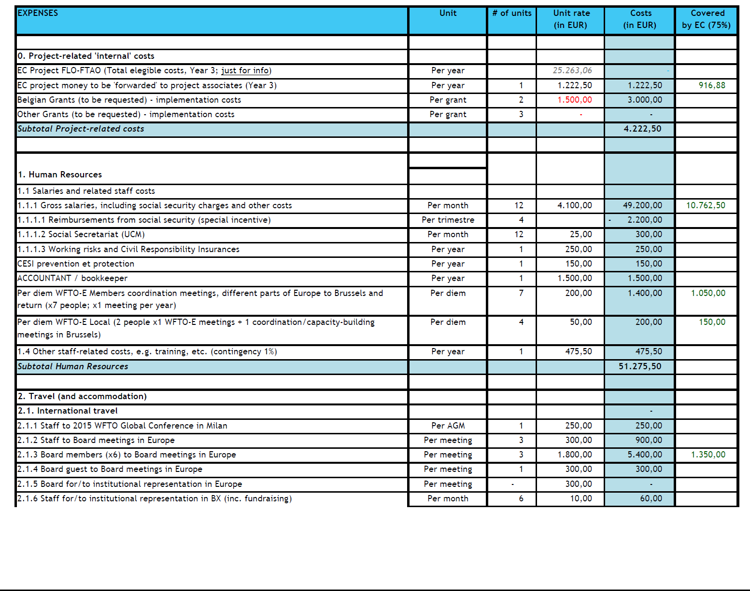
2015 Budget Expenses

Slide 11
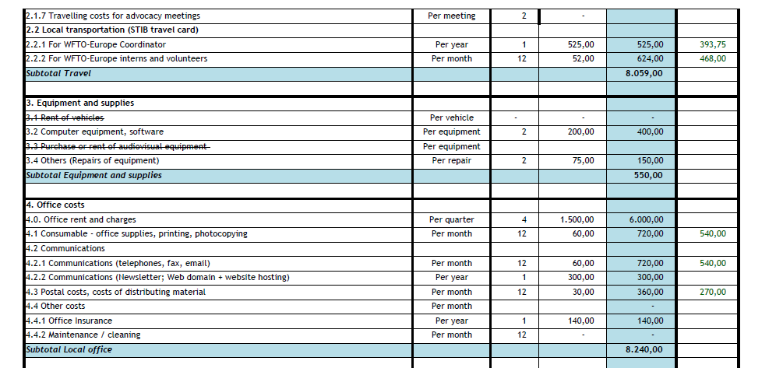
2015 Budget Expenses

Slide 12
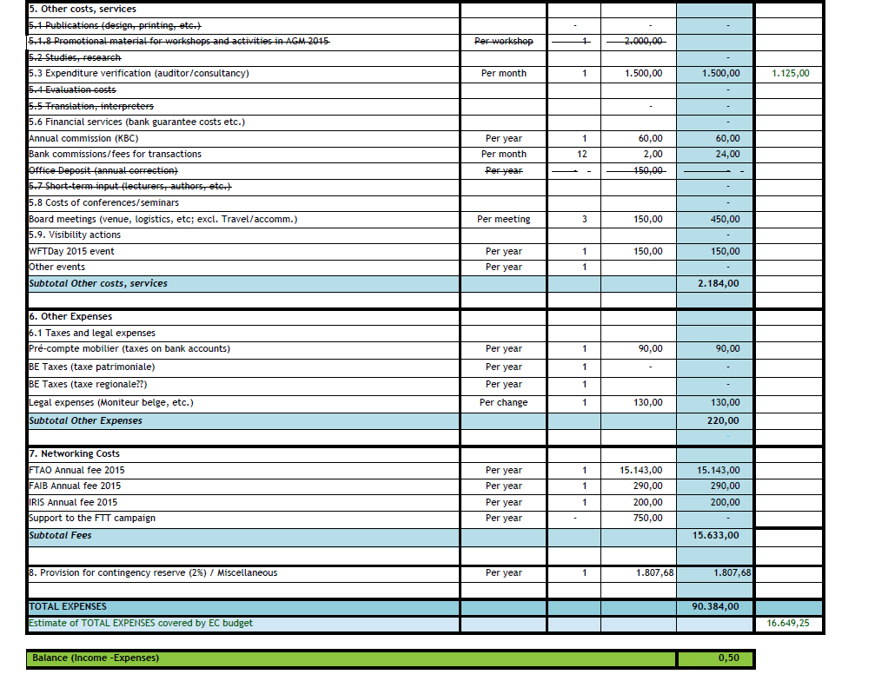
2015 Budget Expenses

